Slide 1
SOF 103
C and C++ Programming
Chapter 3
Operators and Control Structures
(Making Decisions)
Compiled by Dr.Hew

Slide 2
Vision and Mission
Vision
Xiamen University Malaysia aspires to become a university with a distinct global outlook, featuring first-class teaching and research, and embracing cultural diversity.
Mission
To nurture young talents with dignity and wisdom, turning them into fine citizens of the region who will contribute to the prosperity of the people and social progress of Malaysia, China and Southeast Asia.
Compile by Dr. Hew

Slide 3
Last week review
We must declare the variable by specify its name and type before we use it.
Syntax:
  data_type variable_name;
Variable declaration:
  int myNumber;
  Variable Initialization
    number = 5;
  You can also write the above two statements as:
    int number = 5; //variable declaration & initialization
Compiled by Dr.Hew

Slide 4
Last week review
cin takes the value from the user at run time and stores it in the variable.
The syntax :
The example :
int number1;
cin >> number1;
cin >> variable;
Compiled by Dr.Hew

Slide 5
Chapter Overview
Making decisions
Precedence of relational operators
if statement
if-else statement
switch statement
Logical operators
Formatting output
Loops
Compiled by Dr.Hew

Slide 6
1. Making Decisions
Relational Operators
  Relational operators allow you to compare numeric and char values and determine whether one is greater than, less than, equal to, or not equal to another.
So far, the programs that you have written have done the following:
  Gather input from the user
  Perform calculations using arithmetic operators
  Display the result on the screen
Compiled by Dr.Hew

Slide 7
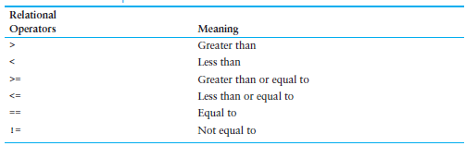
Relational Operators
Compiled by Dr.Hew

Slide 8
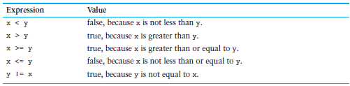
Example of Relational operators
Example Relational Expressions (Assume x is 10 and y is 7)
Compiled by Dr.Hew

Slide 9
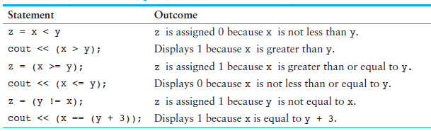
Statements Using Relational Operators
Assume x is 10, y is 7, and z is an int)
Compiled by Dr.Hew

Slide 10

2. Precedence of Relational Operators
Highest to Lowest
Here is an example of how it is applied. If a = 9, b = 24, and c = 0, the following statement would print 1
  cout << (c == a > b);
Because of the relative precedence of the operators in this expression, a > b would be evaluated first.
Compiled by Dr.Hew

Slide 11
3. if Statement
if statement is used to either execute a statement or skip it from execution
if statement uses condition
This condition then decides whether to execute the statement(s) or skip it
Syntax:
if ( condition )
{
_____________
_____________
_____________
}
These statements are executed when the condition is true other wise they are not executed
Compiled by Dr.Hew

Slide 12
Condition
Conditions are also called relational statements
Conditions are expressions that results in true or false
Conditions can be made of relational operators
Operator | Operator in C++ | Description | Example
= | == | Equality | 4 == 5 (false)
≠ | != | Not Equal | 4 != 5 (true)
< | < | Less Than | 4 < 5 (true)
> | > | Greater than | 4 > 5 (false)
≤ | <= | Less than or equal to | 4 <= 5 (true)
≥ | >= | Greater than or equell to | 4 >= 5 (false)
Compiled by Dr.Hew

Slide 13
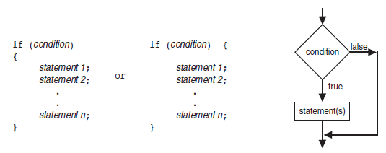
Recommended Ways to Write if Code
Compiled by Dr.Hew

Slide 14
Example
Marks
Write a program that takes student’s marks at run time and displays “congratulations” to those whose marks are greater than 60.
#include<iostream>
int main()
{
int marks;
cout<<“Please enter student marks “;
cin>>marks;
if(marks >= 60)
cout<<“Congratulations”;
}
23 >= 60
FALSE
Output
Please enter student marks
23
23
This statement will be skipped
Compiled by Dr.Hew

Slide 15
Example
Marks
Write a program that takes student’s marks at run time and display “congratulations” to those whose marks are greater than 60.
#include<iostream>
int main()
{
int marks;
cout<<“Please enter student marks “;
cin>>marks;
if(marks >= 60)
cout<<“Congratulations”;
}
78 >= 60
TRUE
Output
Please enter student marks
78
78
Congratulations
Compiled by Dr.Hew

Slide 16
4. if/else SELECTION STRUCTURE
Syntax of if/else statement
if ( condition ) {
_____________
_____________
_____________
}
else {
____________
____________
____________
}
These statements are executed when the condition is true
These statements are executed when the condition is false
Note: In C++ the result of the condition can only have two values: true or false. True is stored as “1” and false is stored as “0” in memory by C++
Compiled by Dr.Hew

Slide 17
Example
  Write a program to take student marks from user and display the result of a student. If marks are greater than 60 then display the message “You are pass” otherwise “You are fail”
  int main()
  {
  int marks;
  cout<<“Please Enter student marks “;
  cin>>marks;
  if(marks >= 60)
  cout<<“You are pass”;
  else
  cout<<“You are fail”;
  }
Compiled by Dr.Hew

Slide 18
Calculate Student Grades
  int main()
  {
  float marks;
  cout<<“Please enter the marks of a student“;
  cin>>marks;
  if(marks >= 90)
  cout<<“A”;
  else if(marks >= 80)
  cout<<“B”;
  else if(marks >= 70 )
  cout<<“C”;
  else if(marks >= 60 )
  cout<<“D”;
  else
  cout<<“Fail”;
  }
Compiled by Dr.Hew

Slide 19
5. Switch Statement
Switch statement is used when we need to select single option between multiple choices
Syntax
  switch (expression)
  {
  case 1: statement(s); break;
  case 2: statement(s); break;
  case 3: statement(s); break;
  .
  .
  .
  .
  case n: statement(s); break;
  default: statement(s);
  }
  Note: switch statement is equal to nested if, where all conditions use equal (==) operator
Compiled by Dr.Hew

Slide 20
Explanation
  switch (expression)
  {
  case 1: statement(s); break;
  case 2: statement(s); break;
  case 3: statement(s); break;
  .
  .
  .
  .
  case n: statement(s); break;
  default: statement(s);
  }
Break is used to stop the execution of other case statements
These values are used for equality with the expression and only corresponding statements will be executed
Compiled by Dr.Hew

Slide 21
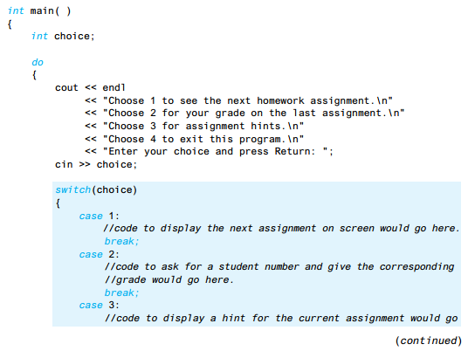
Using ‘Switch’ statement for Menus
A Program to give out homework assignment information
Compiled by Dr.Hew

Slide 22
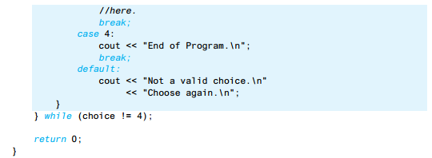
‘Switch’ Cont…
Compiled by Dr.Hew

Slide 23
Write a program to perform arithmetic operations
The user will enter the values and then user will select operation that he wants to perform
  1 → addition
  2 → subtraction
  3 → multiplication
  4 → division
  5 → exit
The user will be prompted with these messages. User will select his required option and your program should display the correct answer based on the user selection
Compiled by Dr.Hew

Slide 24
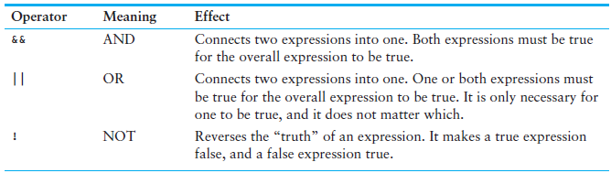
6. Logical Operators
Logical operators connect two or more relational expressions into one or reverse the logic of an expression.
Compiled by Dr.Hew

Slide 25
Logical and operator (&&)
and operator is used when all the conditions in simple conditions must be true to evaluate the overall result into true
The basic rule for and operator are as below
Condition 1 | Condition 2 | Condition 1 && Condition 2
TRUE | TRUE | TRUE
TRUE | FALSE | FALSE
FALSE | TRUE | FALSE
FALSE | FALSE | FALSE
Compiled by Dr.Hew

Slide 26
Write a program that will give 10 percent raise to those employees whose salary is less than or equal to $2000 and greater than or equal to $1200.
#include<iostream>
int main()
{
int salary;
cout<<“Enter employee salary “; cin>>salary;
if(salary >= 1200 && salary <= 2000)
salary = salary + (salary * 10/100);
else
cout<<“No increase in salary “;
cout<<“New salary is = “<<salary;
}
Both conditions must be true to give the increase
Compiled by Dr.Hew

Slide 27
Logical or Operator (||)
or operator is used when at least one of the simple conditions need to be true to evaluate the overall result into true
The basic rule for or operator are as below
Condition 1 | Condition 2 | Condition 1 || Condition 2
TRUE | TRUE | TRUE
TRUE | FALSE | TRUE
FALSE | TRUE | TRUE
FALSE | FALSE | FALSE
Compiled by Dr.Hew

Slide 28
Write a program which increases 10% salary of the employees who are working in category 3 or whose salary is less than 5000
int main()
{
int salary, category;
cout<<“Enter employee salary “;
cin>>salary;
cout<<“Enter employee category “;
cin>> category;
if(salary < 5000 || category == 3)
salary = salary + salary * 10/100;
else
cout<<“No increase in salary “;
cout<<“The salary is “<<salary;
}
Compiled by Dr.Hew

Slide 29
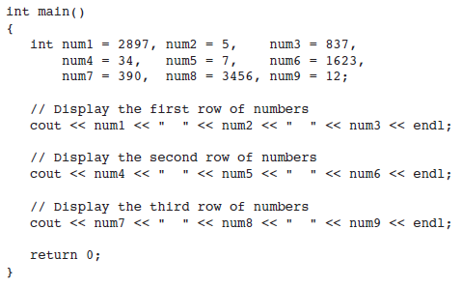
7. Formatting Output
cout provides ways to format data as it is being displayed. This affects the way data appears on the screen.
Compiled by Dr.Hew

Slide 30


Program Output
The numbers do not line up in a column.
We can format the output by using setw manipulator.
Here is an example of how to use it:
The number ‘5’ in the parenthesis spcifies the field width. It means 23 will be displayed in a field of 5 spaces.
Compiled by Dr.Hew

Slide 31

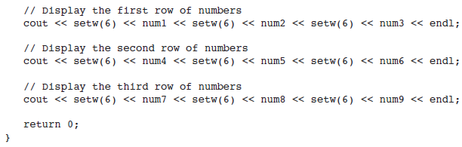
Program to demonstrate setw manipulator
Compiled by Dr.Hew

Slide 32
Increment & Decrement Operators
C++ provides a pair of unary operators for incrementing and decrementing variables.
Here are three different ways to increment the value of the variable num by 1.
  num = num + 1;
  num += 1;
  num++;
And here are three different ways to decrement it by 1:
  num = num - 1;
  num -= 1;
  num--;
Compiled by Dr.Hew

Slide 33
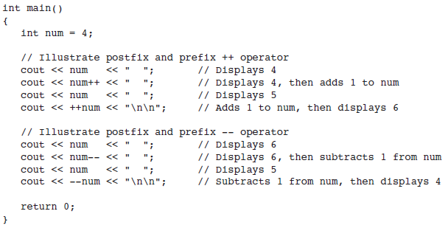

Program to demonstrate ++ and -- Operators
Compiled by Dr.Hew

Slide 34
8. Loops
Repetition structure
  It is used to repeat statement(s) to specified number of time
Deterministic Loop
  When the number of repetitions are known in advance
Non Deterministic Loop
  When number of repetitions are not known in advance
Compiled by Dr.Hew

Slide 35
Types Of Loop in C++
for loop
  Deterministic loop structure – used for known number of repetitions
  It is repeated until some given condition become false
while Loop
  Non Deterministic loop structure – used for unknown number of repetition
  It is also repeated until some specified condition becomes false
do – while Loop
  It is repeated until some given condition becomes false
  The difference between ‘while and do-while’ is that do while will execute at least once, even if the condition is false initially
NOTE: DETERMINISTIC AND NON DETERMINISTIC LOOP CAN BE USED INTERCHANGEABLY
Compiled by Dr.Hew

Slide 36
For statement
The simplest loop structure
Syntax
  for (initialization; condition; increment)
  {
  body of loop;
  }
Compiled by Dr.Hew

Slide 37
Example
Write a program to display numbers from 1 to 10
#include<iostream>
int main()
{
int i;
for(i = 1; i<=10;i++)
cout<<i<<endl;
}
Compiled by Dr.Hew

Slide 38
Example 2
Write a program to display even numbers from 0 to 100
#include<iostream>
int main()
{
int i;
for(i = 0; i<=100;i = i + 2)
cout<<i<<endl;
}
Compiled by Dr.Hew

Slide 39
Example 3
Write a program to display even numbers from 1 to 100
#include<iostream>
int main()
{
int i, remainder;
for(i = 0; i<=100;i ++)
{
remainder = i %2;
if(remainder== 0)
cout<<i<<endl;
}
}
Compiled by Dr.Hew

Slide 40
While Loop
Non-deterministic repetitions
Syntax
    counter = startvalue;
    While (condition)
    {
      Statement(s);
      Increment counter;
    }
Initial Value/Start Value
Loop will repeat when this condition is true
Most important other wise loop will never terminate
Compiled by Dr.Hew

Slide 41
While Loop
Start
    counter = startvalue;
    while (condition){
      Statement(s);
      Increment counter;
    }
Initialization
Increment
Condition
TRUE
Statement(s)
FALSE
Stop
Compiled by Dr.Hew

Slide 42
While Loop _{(cont’d)}
  counter = 1;
Start
  (counter <= 2)
  while
  {
  }
  cout<<counter;
  counter = counter + 1;
counter = 1
counter
counter = counter + 1
3
1
2
counter < = 2
TRUE
Print Counter
1
2
FALSE
Stop
Compiled by Dr.Hew

Slide 43
do – While Loop
Non-deterministic repetitions
Syntax
    counter = startvalue;
    do
    {
      Statement(s);
      Increment counter;
    }while (condition);
Initial Value
Most important other wise loop will never terminate
Loop will repeat when this condition is true
Compiled by Dr.Hew

Slide 44
Do – While Loop
Start
    Counter = startvalue;
    do
    {
      Statement(s);
      Increment counter;
    } while (condition);
Initialization
Statement(s)
TRUE
Condition
Increment
FALSE
Stop
Compiled by Dr.Hew

Slide 45
Do – While Loop _{(cont’d)}
  #include<iostream>
  using namespace std;
  int main()
  {
  int counter;
  counter = 10;
  do
  {
  cout<<counter<<endl;
  counter = counter - 1;
  }while(counter >= 1);
  }
Compiled by Dr.Hew

Slide 46
Non deterministic Loops: while loop
Write a program that will add a list of numbers entered by the user
#include<iostream>
using namespace std;
int main()
{
int sum, num;
sum = 0;
char ch;
cout<<"Enter number to add ";
cin>>num;
sum = sum + num;
cout<<"do you want to add next number ? (y or n)";
cin>>ch;
while(ch == 'y')
{
cout<<"Enter number to add ";cin>>num;
sum = sum + num;
cout<<"do you want to add next number ? (y or n)";
cin>>ch;
}
cout<<"The sum is = "<<sum;
return 0;
}
Compiled by Dr.Hew

Slide 47
Non deterministic Loops: do while loop
Write a program that will add a list of numbers entered by the user
#include<iostream>
int main()
{
int sum, num;
sum = 0;
char ch;
do
{
cout<<“Enter number to add “;
cin>>num;
sum = sum + num;
cout<<“do you want to add next number ? (y or n)”;
cin>>ch;
}while(ch == ‘y’);
cout<<“The sum is = “<<sum;
}
Compiled by Dr.Hew

Slide 48
Nested Loops
Will be discussed about it next week.
Compiled by Dr.Hew

Slide 49
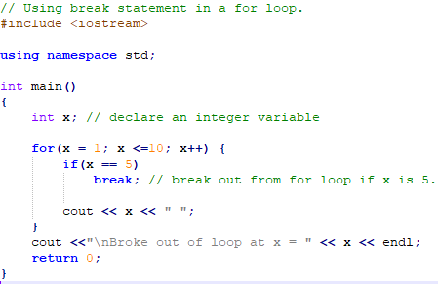
The ‘break’ Statement
The break statement is used to escape early from a loop or to skip the remainder of a switch structure.
Compiled by Dr.Hew

Slide 50
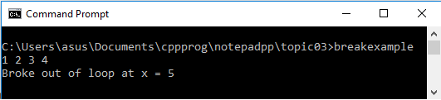
The ‘break’ Statement Cont…
Output of the program:
Compiled by Dr.Hew

Slide 51
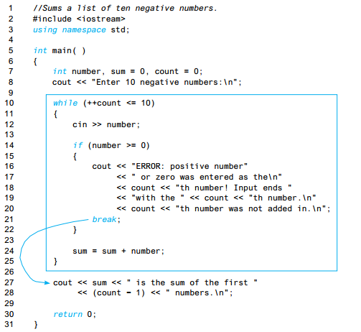
More on ‘break’ statement
Compiled by Dr.Hew

Slide 52
The ‘break’ statement in nested loops
A break statement ends only the innermost loop that contains it. If you have a loop within a loop and a break statement in the inner loop, then the break
statement will end only the inner loop.
Compiled by Dr.Hew

Slide 53
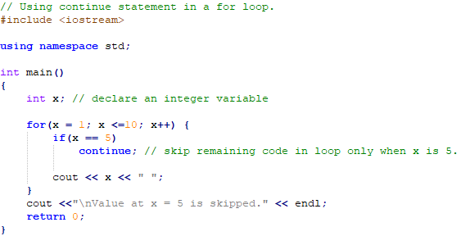
The ‘Continue’ Statement
The continue statement, when executed in any loop structure, skips the remaining statements in the body of that structure, and proceeds with the next iteration of the loop.
Compiled by Dr.Hew

Slide 54
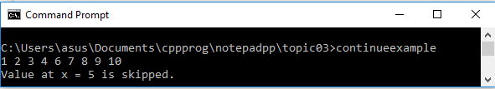
The ‘Continue’ Statement Cont…
Output of the program:
Compiled by Dr.Hew

Slide 55
References
  Problem Solving with C++ (10th Edition), Walter Savitch, Addison Wesley, 2018
  CS201 Introduction to Programming, Virtual University of Pakistan
  Paul J. Dietel, C++ How to Program (10th Edition), Pearson, 2017.
  Turbo C programming for the PC, Robert Lafore
  Dr. Kamran’s notes.
Compiled by Dr.Hew

